Slide 1
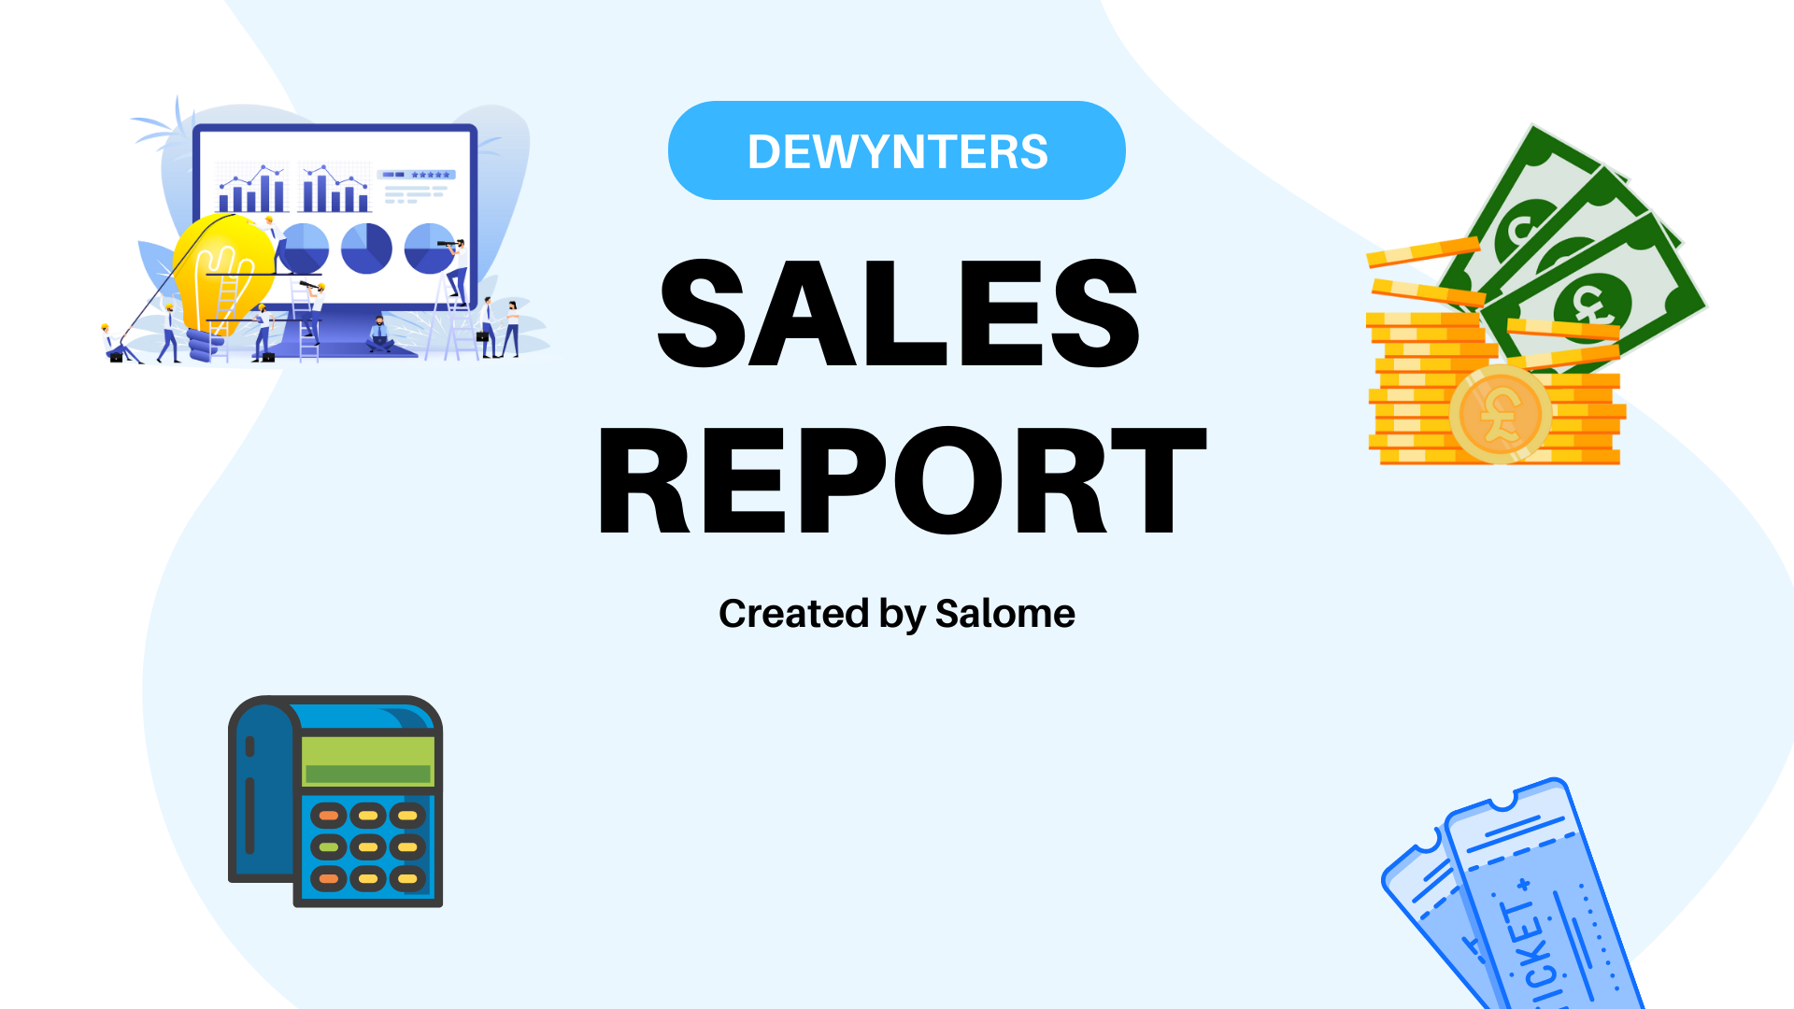
Sales Analysis
By Salome

Slide 2

Sales Overview
February Sales
February Internet Sales
Online Traffic Report
Facebook Campaign Report
Observation And Recommendation

Slide 3
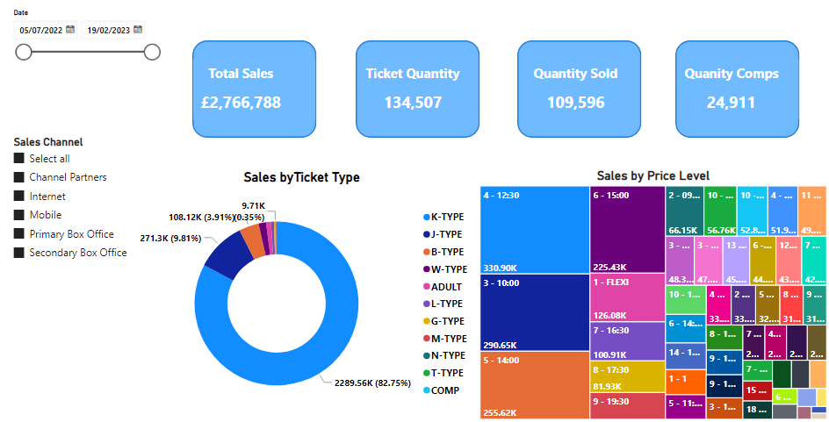
Sales Overview

Slide 4
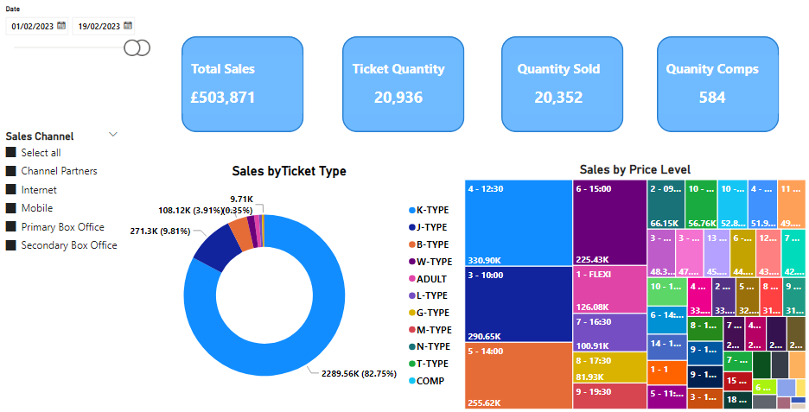
February Sales

Slide 5
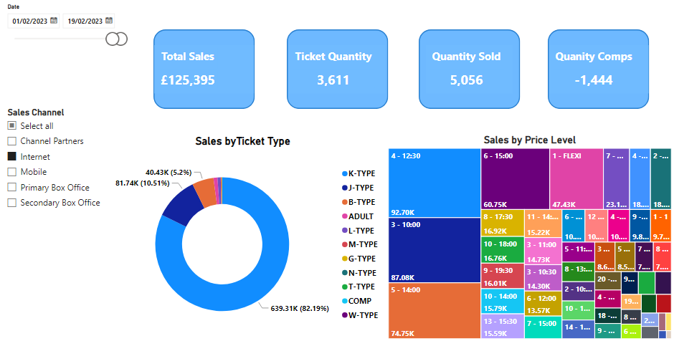
February Internet Sales

Slide 6
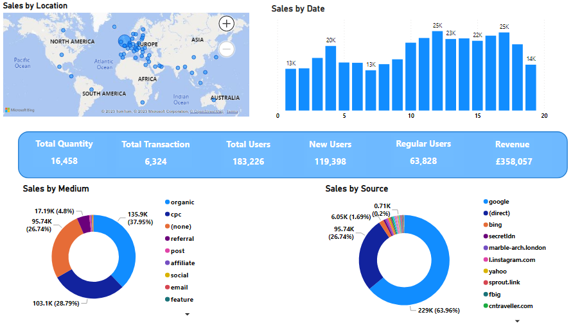
Online Traffic Report

Slide 7
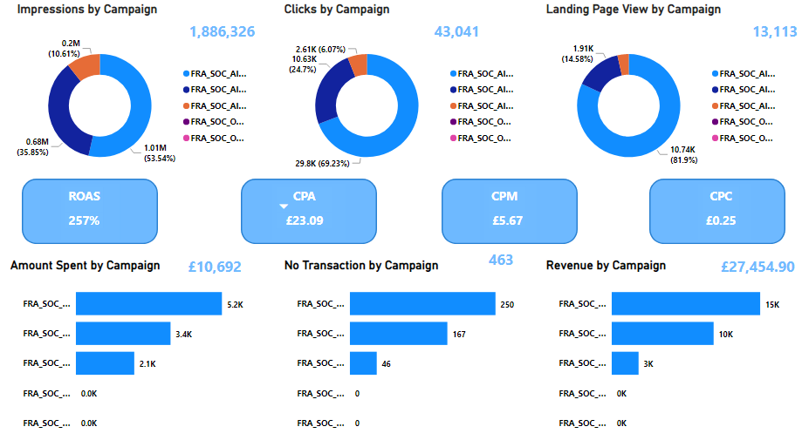
Facebook Campaign Report

Slide 8



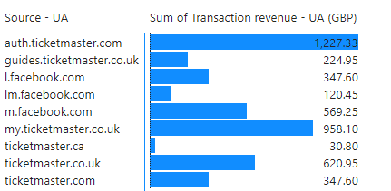
OBSERVATION
Data Error (Ticket)
SUGGESTION
Combine Similar Traffic Source

Slide 9
Questions?

Slide 10
Thank You

